Slide 1
Function of network layer (IP address)

Slide 2
Two key network-layer functions
Services
Routing and forwarding
host to host delivery (Using IP Addressing)
transport segment from sending to receiving host
on sending side encapsulates segments into datagrams
on receiving side, delivers segments to transport layer
network layer protocols in every host, router
router examines header fields in all IP datagrams passing through it
Forwarding: move packets from router's input to appropriate router output
Routing: determine route taken by packets from source to destination

Slide 3
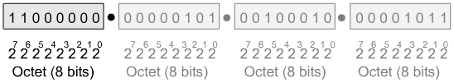
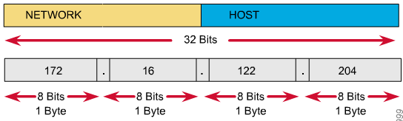
IPv4 Addressing
IP Address as a 32-bit binary number (Four Octet)

Slide 4
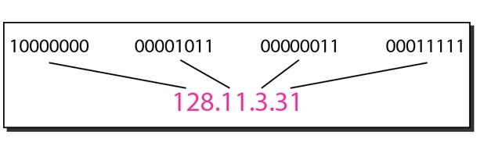
Binary to DDN conversion
Eg:
– Change the following IPv4 addresses from binary notation to dotted-decimal notation
10000001 00001011 00001011 11101111
Solution
129.11.11.239

Slide 5
Eg: Change the following IPv4 addresses from dotted-decimal notation to binary notation
111.56.45.78
Solution
01101111 00111000 00101101 01001110
Eg:
Find the error, if any, in the following IPv4 addresses
– a. 111.56.045.78
– b. 221.34.7.8.20
– c. 75.45.301.14
– d. 11100010.23.14.67
Solution
a. There should be no leading zeroes (045)
b. We may not have more than 4 bytes in an IPv4 address
c. Each byte should be less than or equal to 255
d. A mixture of binary notation and dotted-decimal notation

Slide 6
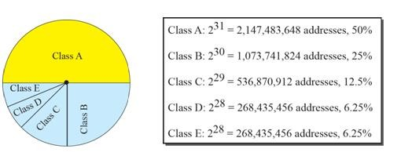
IPv4 Addressing Classification
IPv4 addresses can be classified on 2 ways
Classful Addressing
Classless Addressing

Slide 7
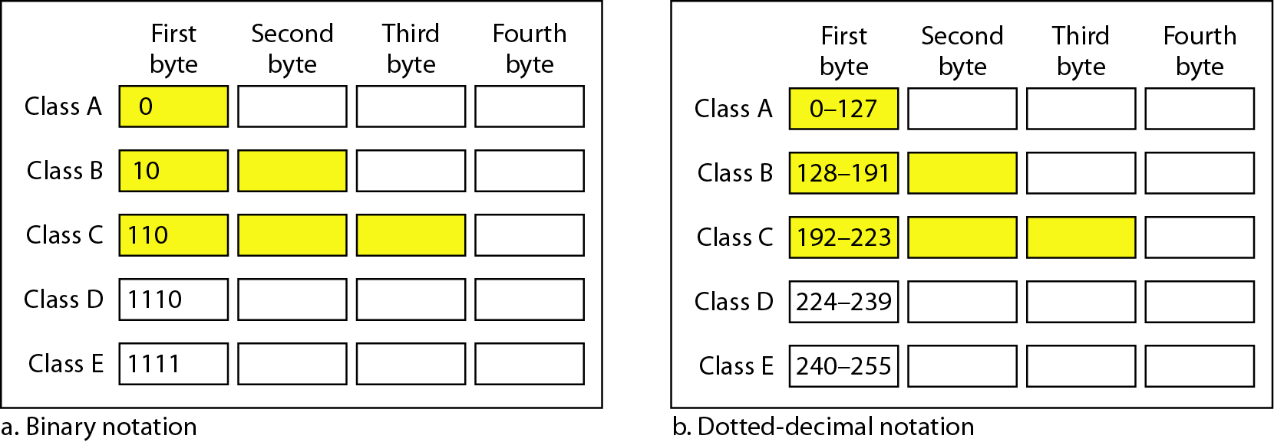
Classful addressing
In classful addressing, the address space is divided into five classes: A, B, C, D, and E

Slide 8
Classful addressing
Class | Net ID bits | Host ID bits | Binary | DDN | No of networks | No of host/Nw | Default mask | CIDR
A (2^31) | 8 | 24 | 0 | 0-127 | 2^7=128 | 2^24 | 255.0.0.0 | /8
B (2^30) | 16 | 16 | 10 | 128-191 | 2^14 | 2^16 | 255.255.0.0 | /16
C (2^29) | 24 | 8 | 110 | 192-223 | 2^21 | 2^8 | 255.255.255.0 | /24
D (2^28) | NA | NA | 1110 | 224-239 | NA | NA | NA | NA
E (2^28) | NA | NA | 1111 | 240-255 | NA | NA | NA | NA
CIDR = classless Interdomain Routing Notation
DDN = Dotted Decimal Notation

Slide 9
Eg:
Find the class of each address
– a. 00000001 00001011 00001011 11101111
– b. 11000001 10000011 00011011 11111111
– c. 14.23.120.8
– d. 252.5.15.111
Solution
a. The first bit is 0. This is a class A address
b. The first 2 bits are 1; the third bit is 0. This is a class C address
c. The first byte is 14; the class is A
d. The first byte is 252; the class is E

Slide 10
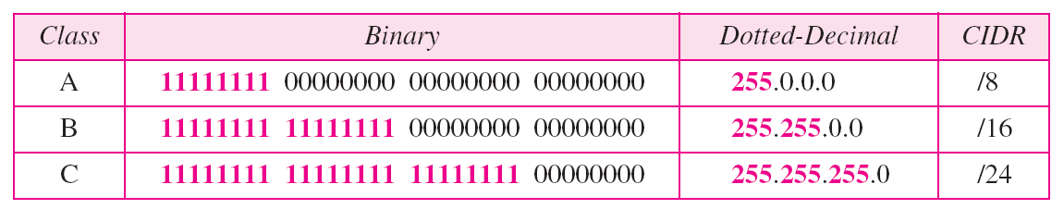
Consists of Net ID and Host ID
Mask
32-bit number of contiguous 1‟s followed by contiguous 0‟s
To help to find the net ID and the host ID

Slide 11
Use of IPv4 Address
Subnetting
Divide a large address block into smaller sub-groups
Use of flexible net mask
Supernetting
Exhausted class A and B address space
Huge demand for class B address space
To combine several contiguous address spaces into a larger single address space

Slide 12
Classless Addressing
To overcome the depletion of address space
Restriction
The addresses in a block must be contiguous
The number of addresses in a block must be a power of 2
The first address must be evenly divisible by the number of address
Mask
Consists of n consecutive 1‟s followed by zeros
n can be any number b/w 0 and 32

Slide 13
In IPv4 addressing, a block of addresses can be defined as x.y.z.t /n, in which
x.y.z.t defines one of the addresses and the /n defines the mask
The first address in the block can be found by setting the rightmost 32 − n bits to 0s
The last address in the block can be found by setting the rightmost 32 − n bits to 1s
The number of addresses in the block can be found by using the formula ₂32−n

Slide 14
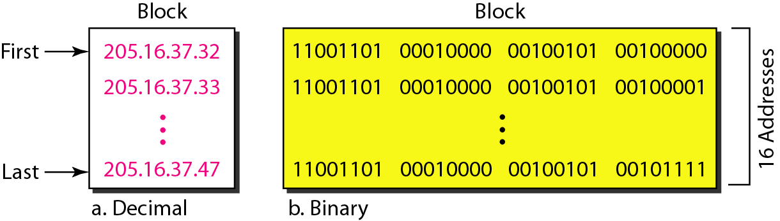
Eg
Figure shows a block of addresses, in both binary and dotted-decimal notation, granted to a small business that needs 16 addresses
We can see that the restrictions are applied to this block. The addresses are contiguous. The number of addresses is a power of 2 (16 = 2⁴), and the first address is divisible by 16.

Slide 15
Eg:
A block of addresses is granted to a small organization. We know that one of the addresses is 205.16.37.39/28. What is the first address in the block?
Solution
The binary representation of the given address is
11001101 00010000 00100101 00100111
If we set 32−28 rightmost bits to 0, we get
11001101 00010000 00100101 0010000
Or
205.16.37.32

Slide 16
Eg:
Find the last address for the block in previous example Solution
The binary representation of the given address is
11001101 00010000 00100101 00100111
If we set 32 − 28 rightmost bits to 1, we get
11001101 00010000 00100101 00101111
or
205.16.37.47

Slide 17
Eg:
Find the number of addresses in the previous example Solution
The value of n is 28, which means that number of addresses is 2³²⁻²⁸ or 16

